Slide 1

National University of Singapore
CarbonEasy!
Carbon Emissions Calculator
Data Dynamics

Slide 2

Introduction
Our web application is designed to calculate and visualize carbon emissions for office buildings in Singapore. It includes two calculators:
Standardized Calculator: Calculates total carbon emissions based on user inputs.
Prediction Calculator: Predicts emissions using a machine learning model.
Users can input data manually or upload CSV files. The results include total emissions, data visualizations comparing emissions to industry averages, and a personalized report generated by OpenAI's API.

Slide 3
Data Collection and Processing
Data Sourcing
Public databases and reports provided by international organizations and energy regulators such as U.S. Environmental Protection Agency (EPA), ENERGY STAR Portfolio Manager, Global Building Performance Network (GBPN), and respective government portals.
Academic studies to supplement missing emission factors, especially for Scope 3 emissions related to office building operations (e.g., waste management, business travel).
Industry white papers that provided additional insights on energy usage patterns and emissions.
Self-reported operational data from office building operators
Detailed energy consumption records for electricity, water and natural gas, for calculating both direct (Scope 1) and indirect (Scope 2) emissions.
Third-Party monitoring platforms for broader coverage of emissions data across diverse regions and building types, and benchmarks to compare and enrich our collected data.
Data Processing
Data Cleaning and Transformation
Drop Unnecessary Columns
Replace Missing Entries
Convert Columns to Numeric
Replace Negative Values
Identify and Handle Missing Values
Rename Columns
ty

Slide 4
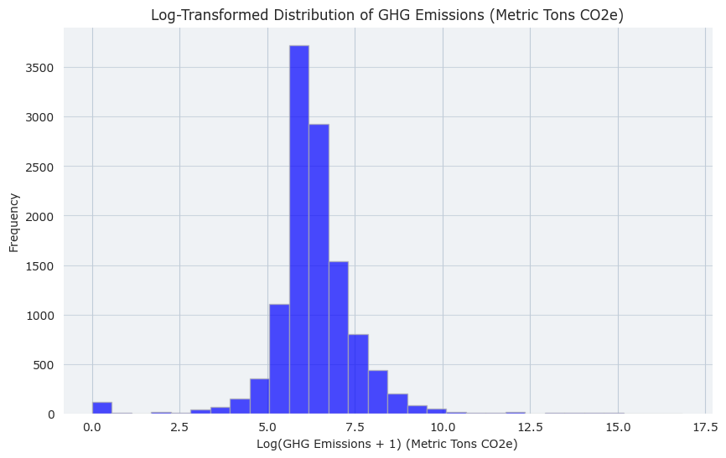
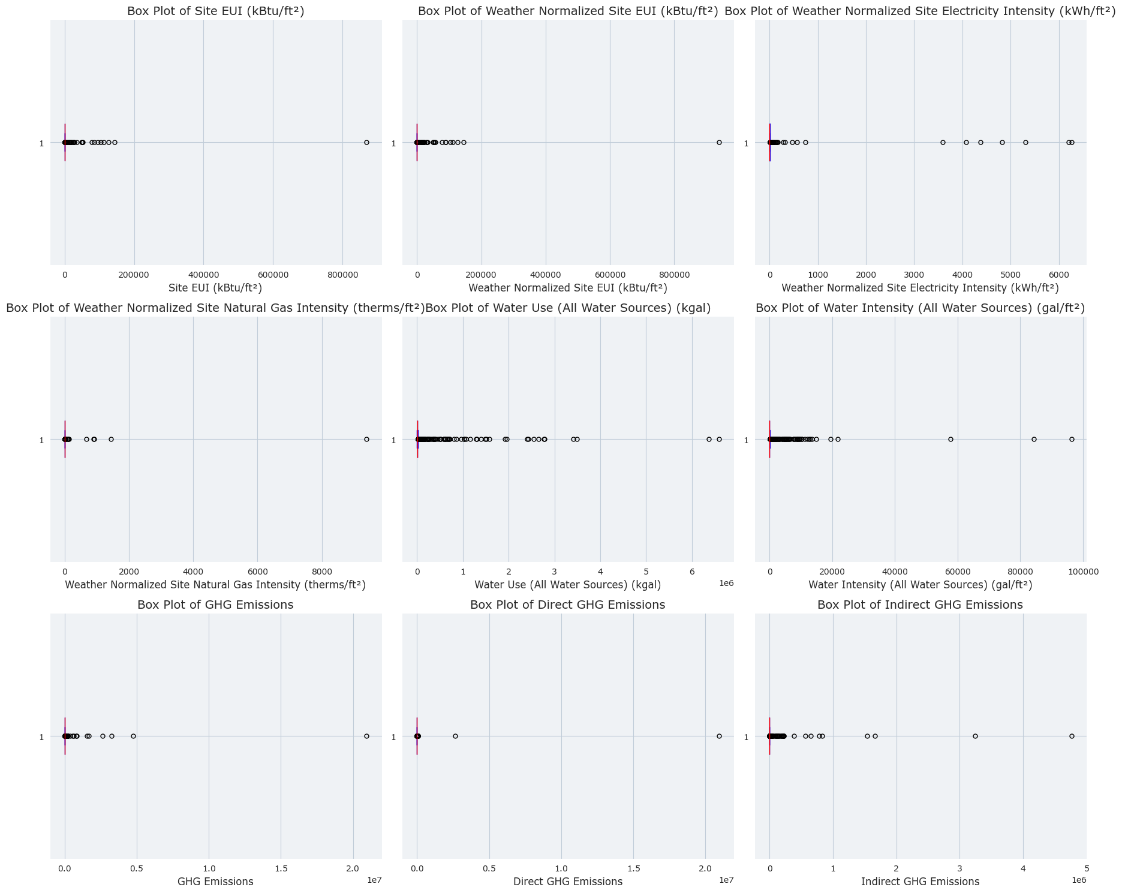
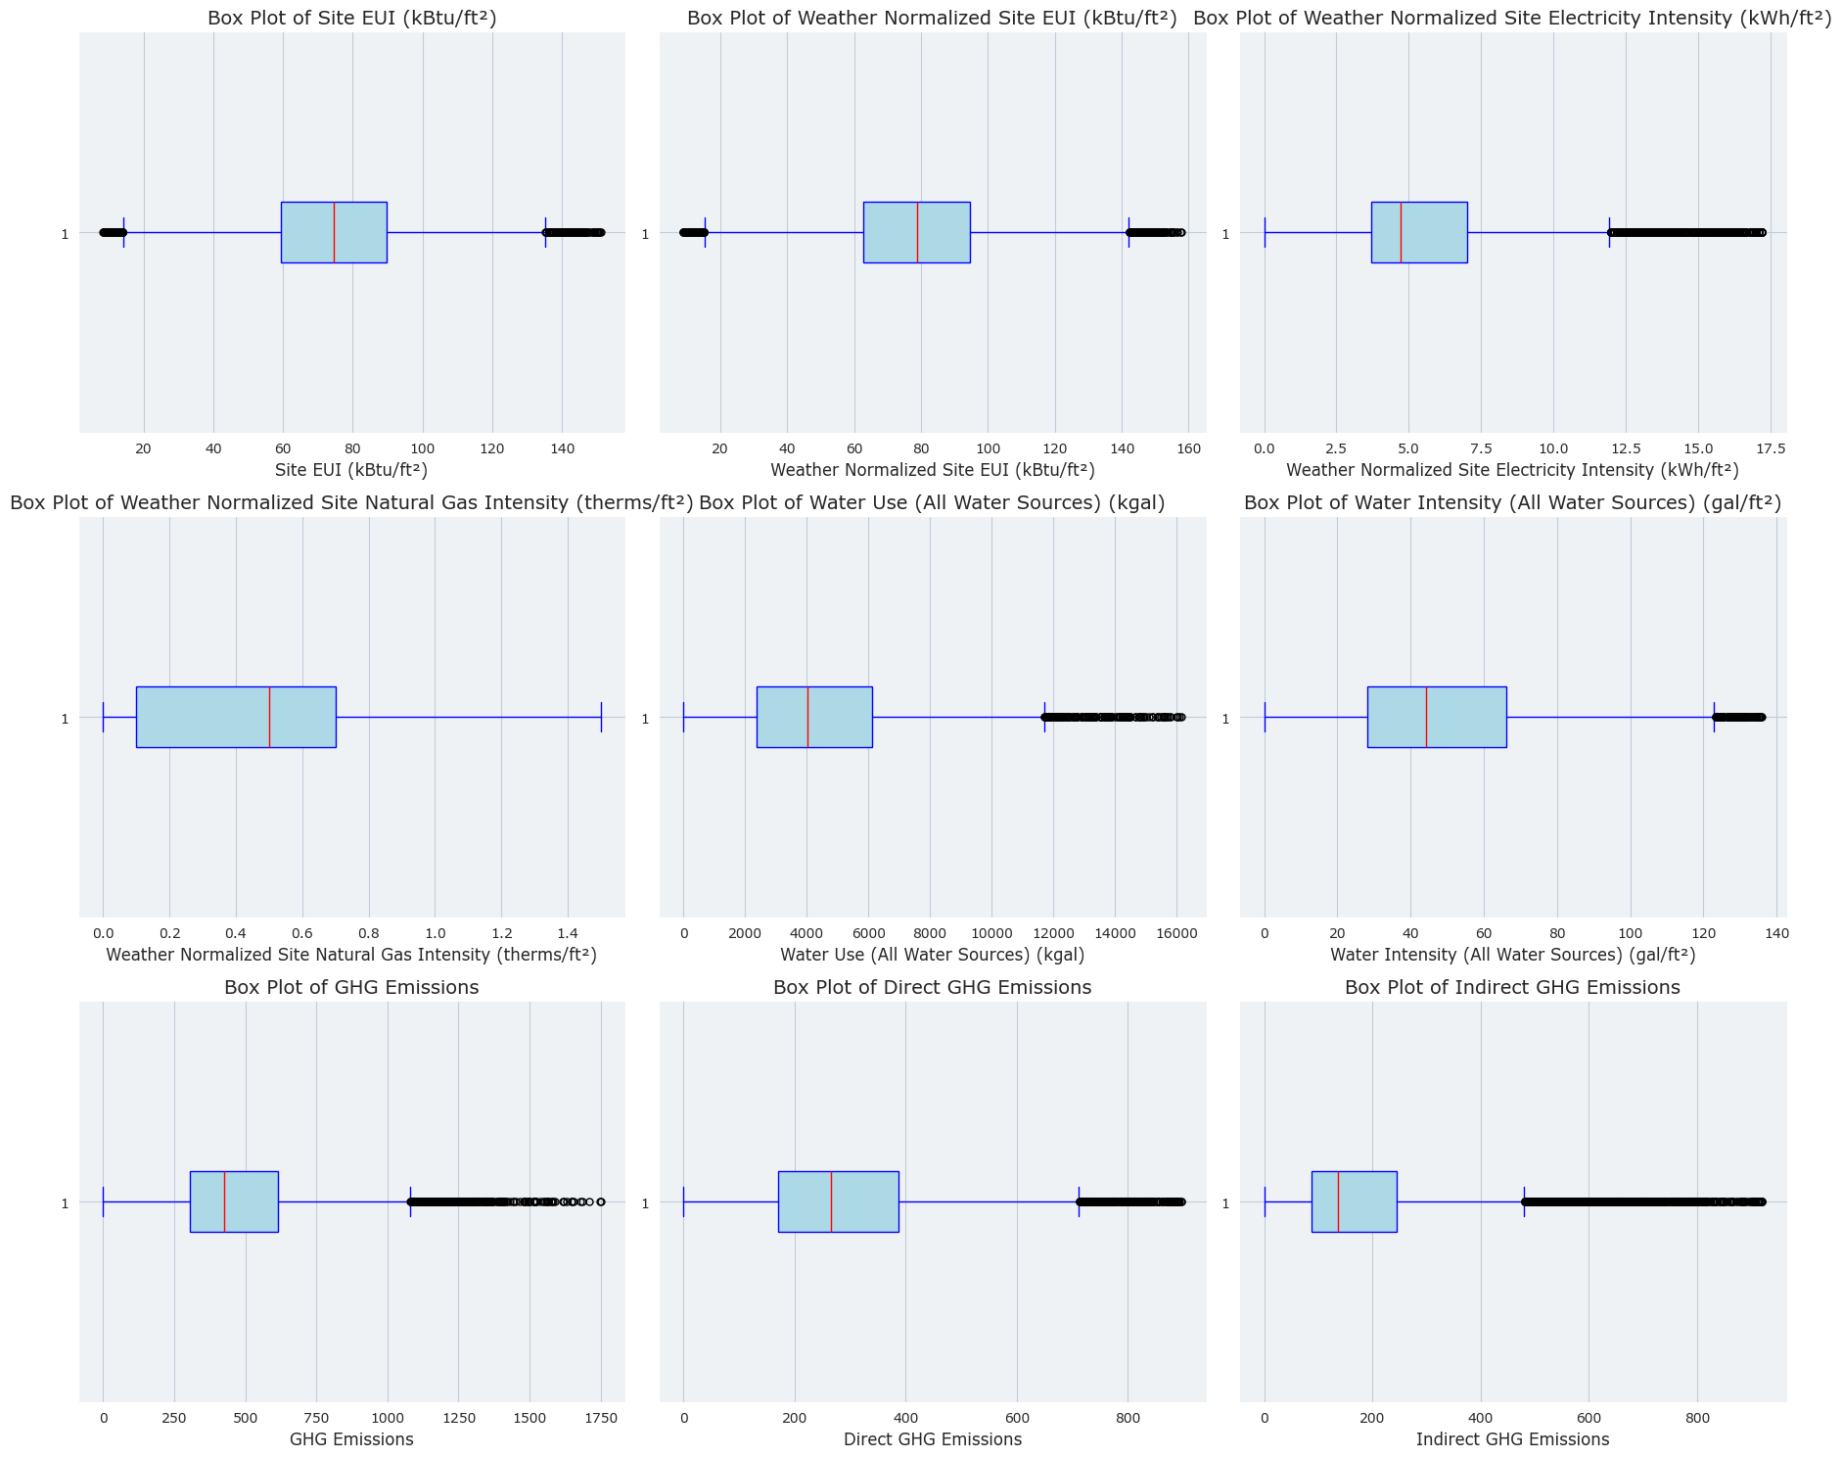
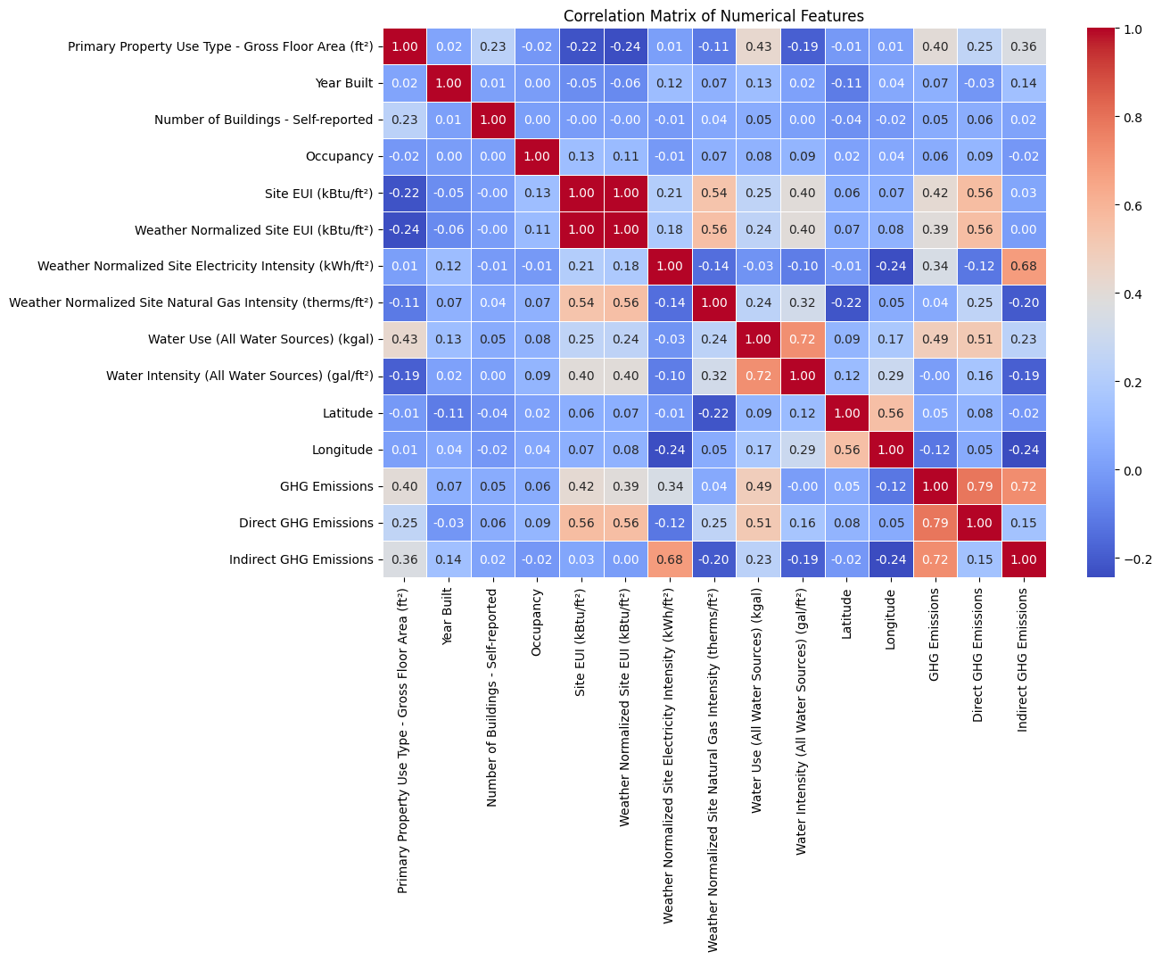
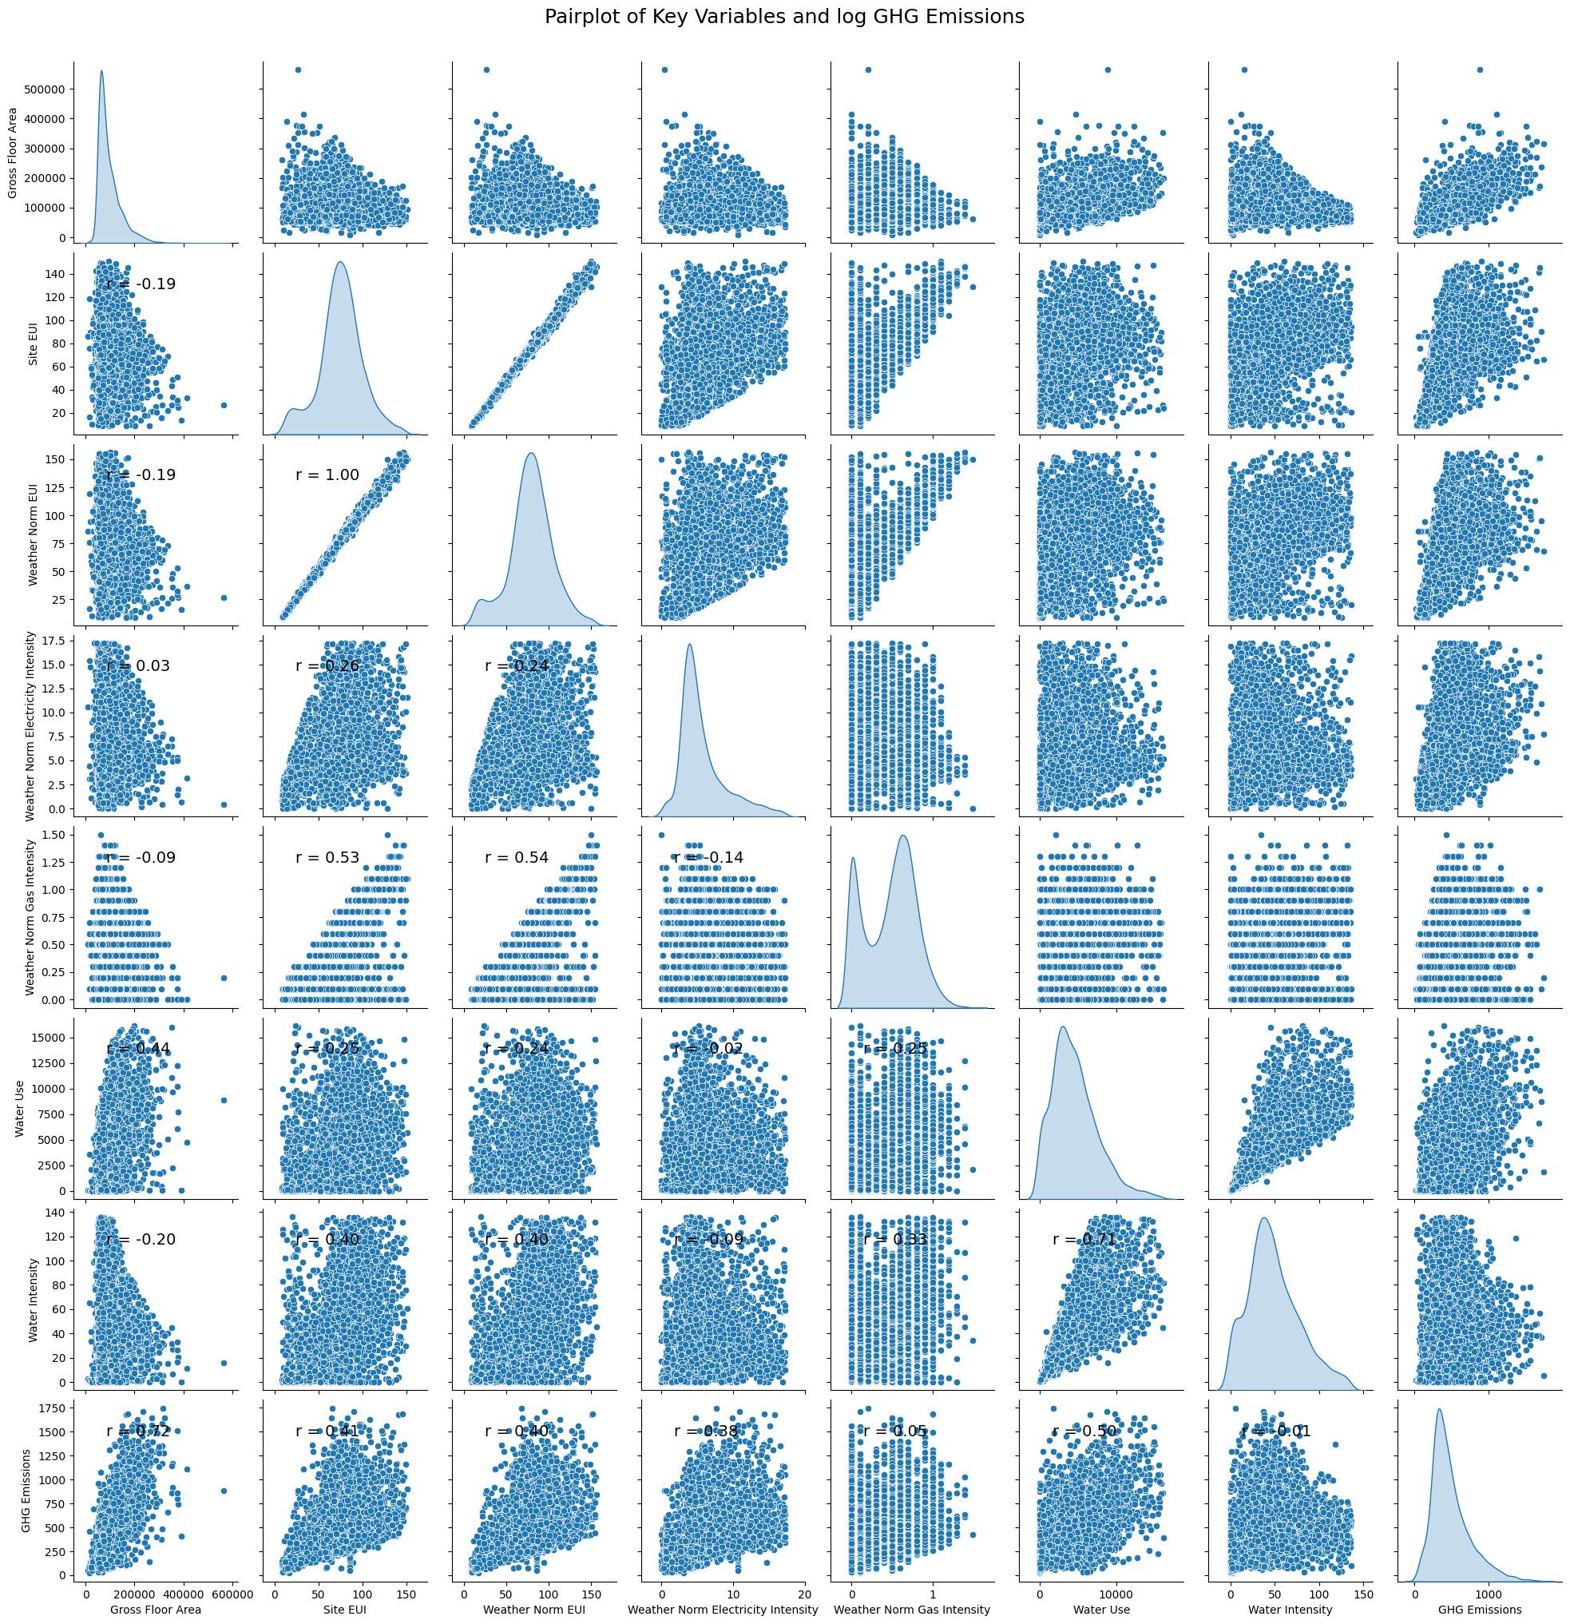
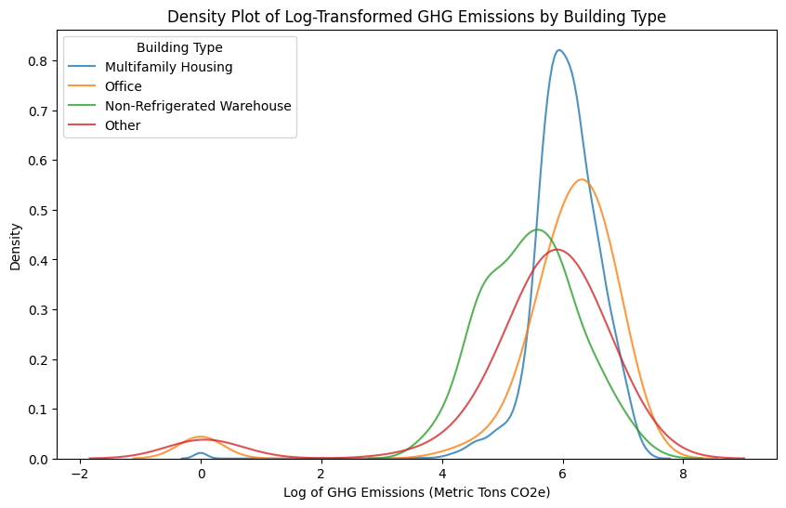
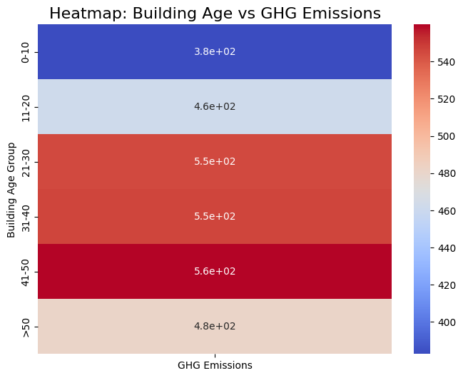
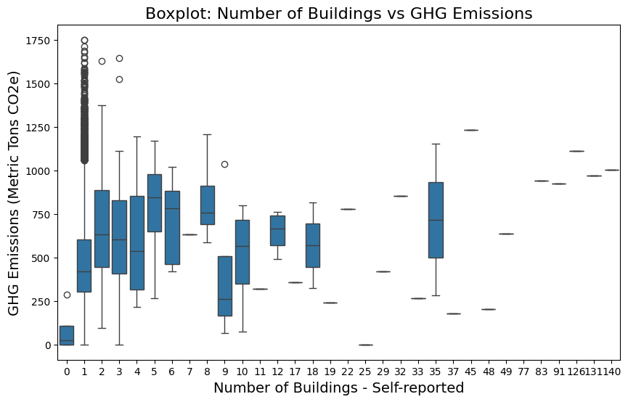
Exploratory Data Analysis
Distribution Analysis
Histograms are plotted to visualize the distribution of GHG emissions. Noted skewness, aggregation and outliers.
Outliers removed using IQR.
Correlation Analysis – Heatmap.
Pair Plot Analysis
Correlation Analysis and Chart Generation to Explore Relationships Between Key Variables and GHG Emissions
Density Plots Distribution of Log-transformed GHG Emissions Across Building Types
Heatmap Analysis by Building Age
Box Plots to Analyse GHG emissions by Building Count and Occupancy rate to analyze GHG emissions
ty

Slide 5
Model Development for Activity-Based Emission Calculation
Method 1: Direct Emission Factor Calculation Method
Overview
This method estimates greenhouse gas (GHG) emissions by directly multiplying resource usage by emission factors. Emission factors represent the CO₂-equivalent emissions per unit of resource consumption, covering various resource types such as water, electricity, gas, and waste.
Key Features
Simple to Implement: Calculates emissions by directly multiplying usage by emission factors.
Flexible: Supports various resource types with customizable emission factors.
Transparent: Easy-to-follow process suitable for quick deployment.
Advantages of the Direct Emission Factor Method
Simplicity: Easy to implement and ideal for quick emission estimates.
Flexibility: Emission factors can be updated for regional or standard variations.
Scalability: Capable of handling multiple resource types and large datasets.
ty

Slide 6
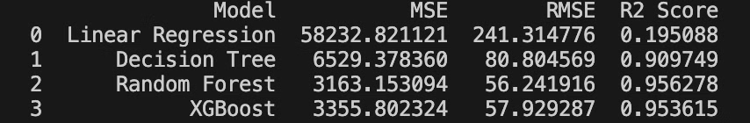
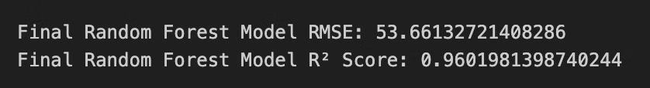
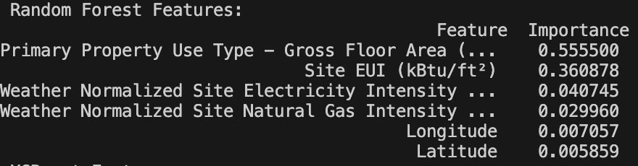
Model Development for Activity-Based Emission Calculation
Method 2: Machine Learning Prediction Models
1
Model Selection
Selected Based on Performance Metrics
Comparison of R² and RMSE values across models.
Highlight Random Forest as the optimal choice due to:
Highest R² (0.956).
Lowest RMSE (56.24).
Performance metrics table generated.
2
Parameter Optimization
Hyperparameter Tuning carried out for Random Forest
Hyperparameters adjusted:
max_depth = 15
n_estimators = 200
Improved model performance after tuning enhances model accuracy and robustness.
3
Feature Selection
Identified Top 6 Important Features for Prediction using Random Forest:
Primary Property Use Type – Gross Floor Area (Importance: 0.555).
Site EUI (kBtu/ft²) (Importance: 0.361).
Weather Normalized Site Electricity Intensity (Importance: 0.041).
Weather Normalized Site Natural Gas Intensity (Importance: 0.030).
Longitude (Importance: 0.007).
Latitude (Importance: 0.006).

Slide 7
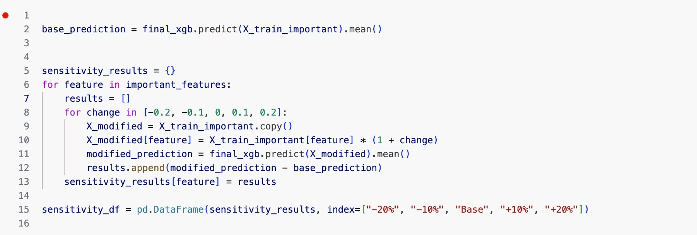
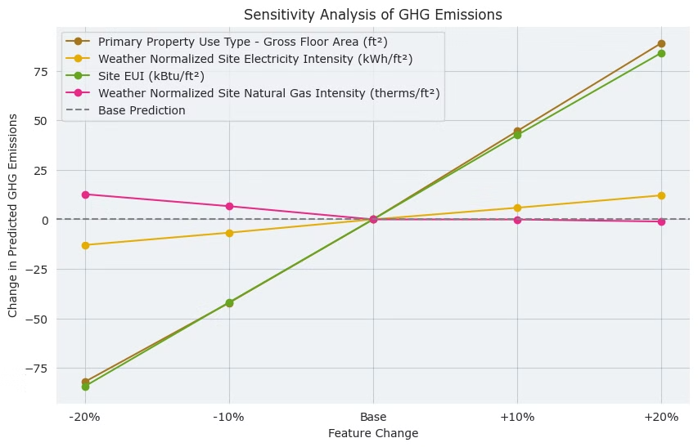
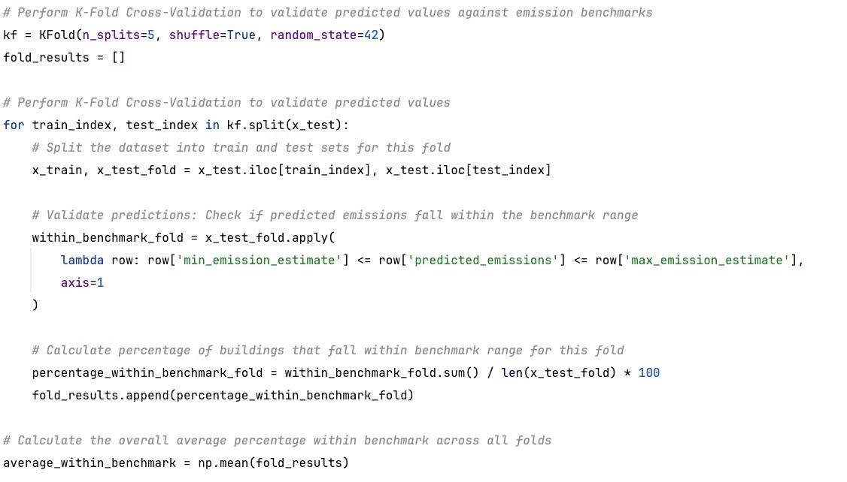
Sensitivity Analysis of GHG Emissions
Evaluation of impact of key features on predicted GHG emissions:
Primary Property Use Type - Gross Floor Area (ft²), Site EUI (kBtu/ft²), and Weather Normalized Site Natural Gas Intensity (therms/ft²) have the largest impact on GHG emissions predictions.
Weather Normalized Site Electricity Intensity (kWh/ft²) shows relatively lower sensitivity compared to other features.
The plot shows the effect of changing each feature by -20%, -10%, 0%, +10%, and +20%.
The gray dashed line represents the baseline prediction without feature change.
Validation System
Validation steps of predicted GHG emissions against benchmark ranges using K-Fold Cross-Validation:
Perform 5-Fold Cross-Validation to compare predicted emissions with emission benchmarks.
For each fold, calculate the percentage of predictions that fall within the benchmark range.
Results:
Percentage Within Benchmark (Per Fold): 67.15%, 65.41%, 66.86%, 66.57%, 65.12%
Overall Average Percentage Within Benchmark: 66.22%

Slide 8
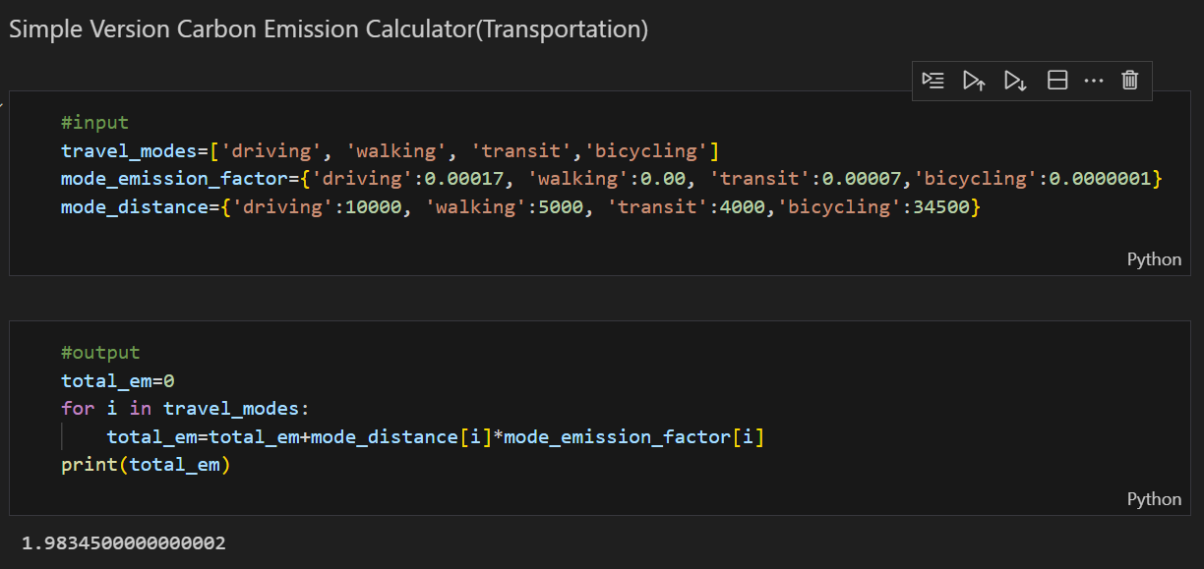
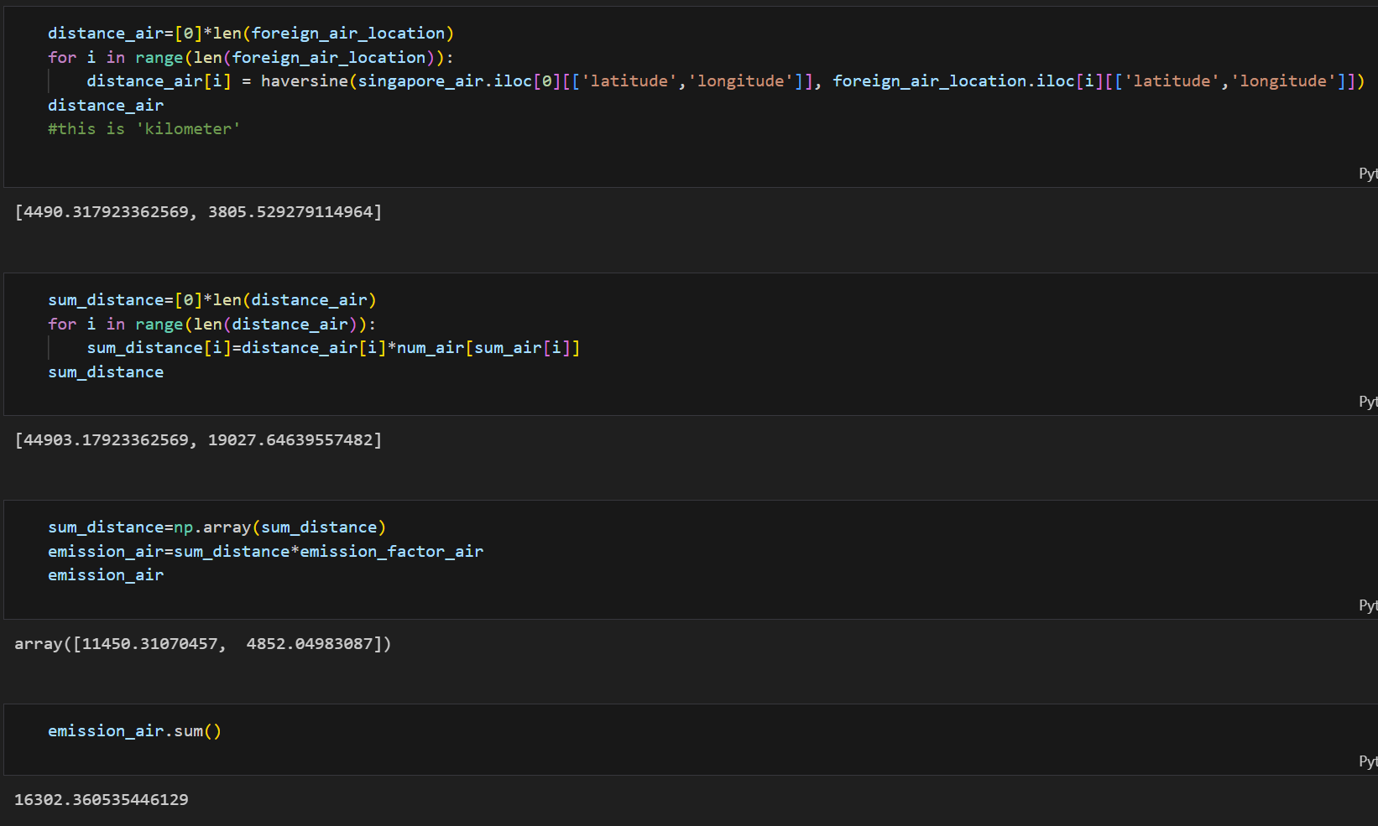
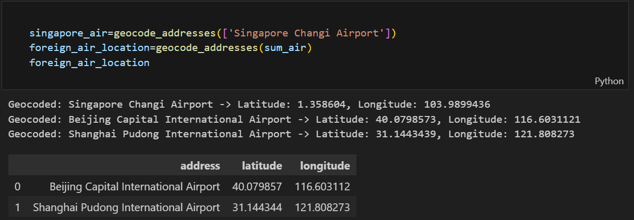
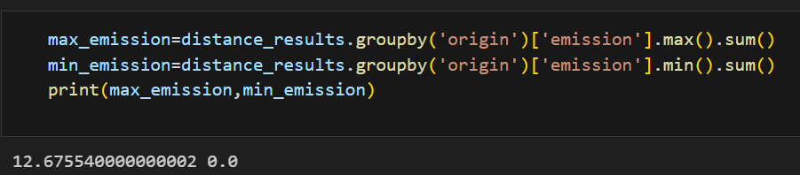
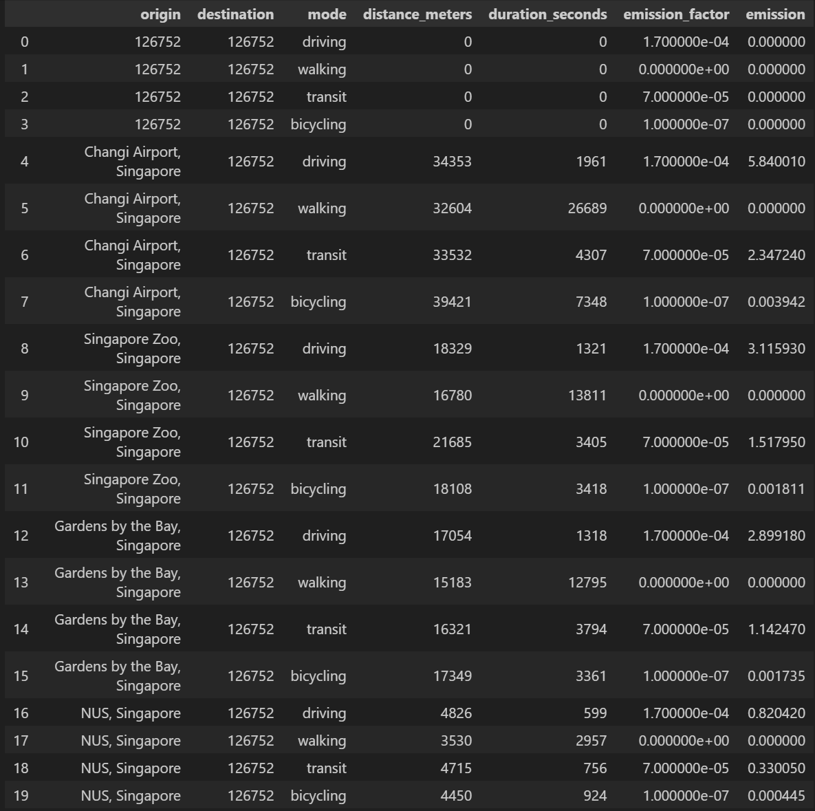
Model Extensions - Transportation & Resource Management
Employee and Business Travel Emissions
Business Travel
Basic Transportation Emissions Calculator
Focuses on emissions from international flights, which are a significant source of greenhouse gases.
Utilizes Google Maps API to convert airport names into coordinates, then applies the Haversine Formula to compute distances between airports.
By default, flights are calculated from Singapore Changi Airport. Users can input multiple destination airports and the number of travelers to determine total emissions.
Commuting modes such as driving, walking, transit, and bicycling are categorized.
Emissions are calculated by multiplying the corresponding emission factors with the total distances traveled for each mode.
Transportation Emissions Calculator with Real-Time
Data
Uses Google Maps API to convert addresses, zip codes, or coordinates into distances and travel times for four transportation modes (driving, transit, bicycling, walking).
Calculates emissions using real-time commuting data for Singapore. Outputs maximum and minimum emissions for given modes. If specific commuting modes per person are provided, individual emissions are calculated using relevant emission factors.

Slide 9
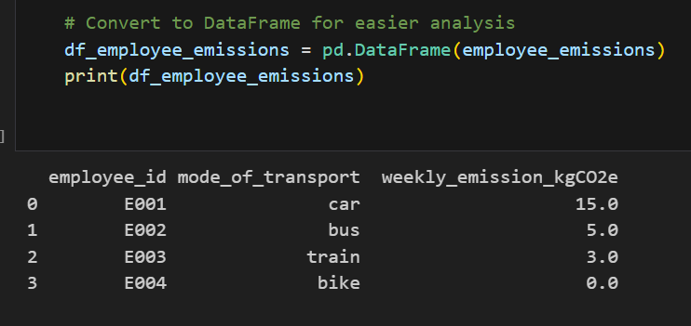
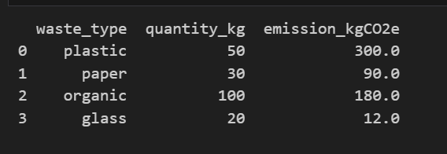
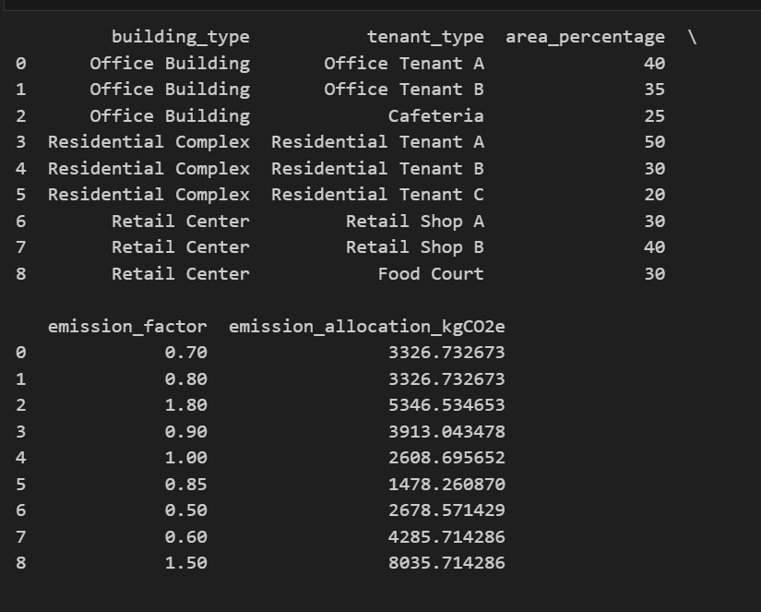
Model Extensions - Transportation & Resource Management
Shared Building Emissions and Resource Management
Carbon Emission Allocation and Tracking
Procurement
Waste Management
Separates buildings into Office, Residential, and Retail categories to allocate emissions based on tenant usage.
Allocates emissions according to the percentage of space occupied by tenants, adjusted by specific emission factors.
Allows users to track monthly emissions for different tenants by updating data on area usage, occupants, and additional utility consumption (water, electricity).
Calculates emissions related to procurement activities by factoring in the number of staff, their transportation modes, and procurement frequency.
Computes weekly emissions using corresponding emission factors for different transportation types.
Calculates emissions using real-time commuting data for Singapore. Outputs maximum and minimum emissions for given modes. If specific commuting modes per person are provided, individual emissions are calculated using relevant emission factors.

Slide 10











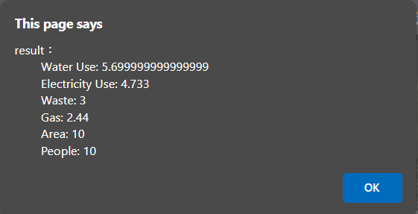
Standard Calculator
Total carbon dioxide equivalent (CO₂e) emissions calculated based on provided activity data and emission factors.
Example:
Activity Data
Water: 1000 m³
Electricity: 5000 kWh
Gas: 2000 kWh
Waste: 300 m³
Emission Factors:
Water: 0.57 kg CO₂e/m³
Electricity: 0.4733 kg CO₂e/kWh
Gas: 0.244 kg CO₂e/kWh
Waste: 0.2 to 0.4 kg CO₂e/m³ (range)
Water Usage
Gas Usage
Waste Generated
Electricity Usage
Calculations Steps:
Water Emissions: 1000 m³ × 0.57 kg CO₂e/m³ = 570 kg CO₂e
Electricity Emissions: 5000 kWh × 0.4733 kg CO₂e/kWh = 2366.5 kg CO₂e
Gas Emissions: 2000 kWh × 0.244 kg CO₂e/kWh = 488 kg CO₂e
Waste Emissions:
Minimum: 300 m³ × 0.2 kg CO₂e/m³ = 60 kg CO₂e
Maximum: 300 m³ × 0.4 kg CO₂e/m³ = 120 kg CO₂e
Results:
Total Emissions:
Minimum Total: 570 + 2366.5 + 488 + 60 = 3484.5 kg CO₂e
Maximum Total: 570 + 2366.5 + 488 + 120 = 3544.5 kg CO₂e
Interpretation:
The total CO₂e emissions range between 3484.5 kg and 3544.5 kg.
The emission factor for waste is provided as a range (0.2 to 0.4 kg
CO₂e/m³).
This range accounts for variability in waste composition and treatment methods.
For a more precise calculation, it's advisable to determine the specific emission factor
based on the exact type of waste and its disposal method.
Data Upload Via CSV File
Total Area and Workforce Count

Slide 11
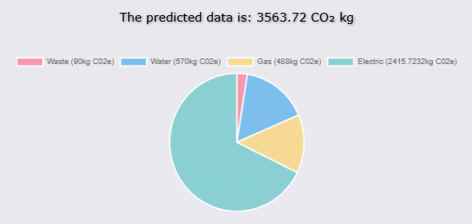

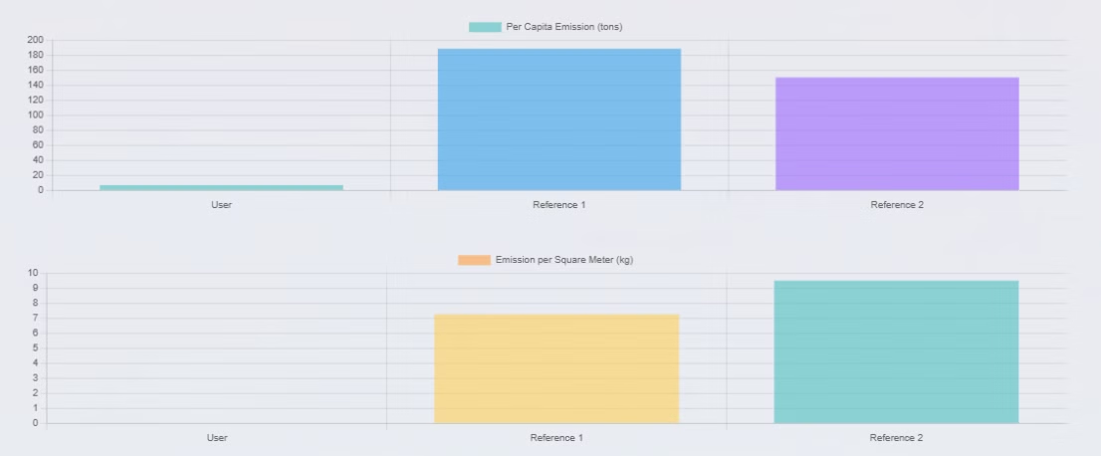
Result Illustrations and Report
Breakdown of Contribution of Each Activity
AI-Generated Report and Recommendations
Per Capita and Per Square Meter Comparison With Benchmark

Slide 12

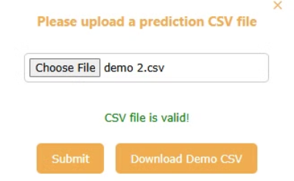
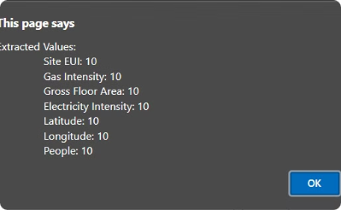
Predictive Calculator
Data Input
Upload data
Calculation Results
This image illustrates the data input process in the Predictive Calculator, showcasing its simplicity and efficiency.
This image shows that users can upload data via data file in CSV format.
This image displays the results generated by the Predictive Calculator, emphasizing accuracy and detail.

Slide 13
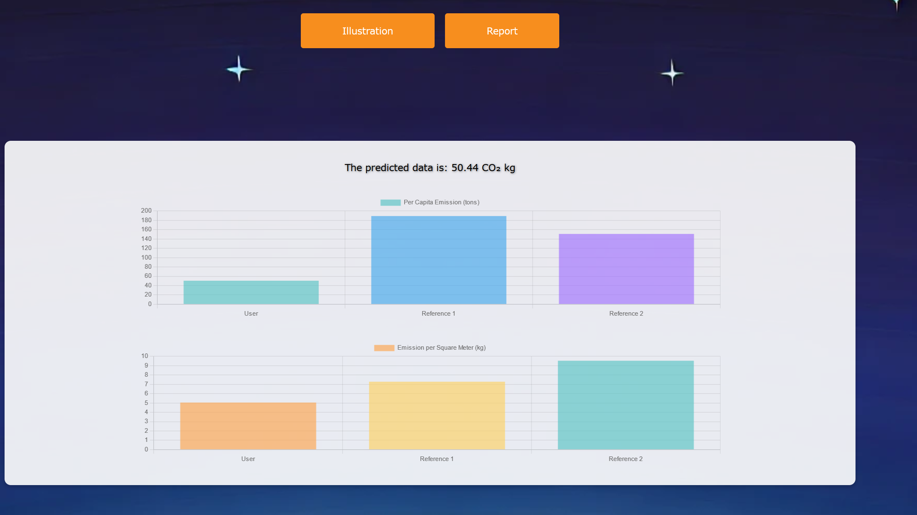
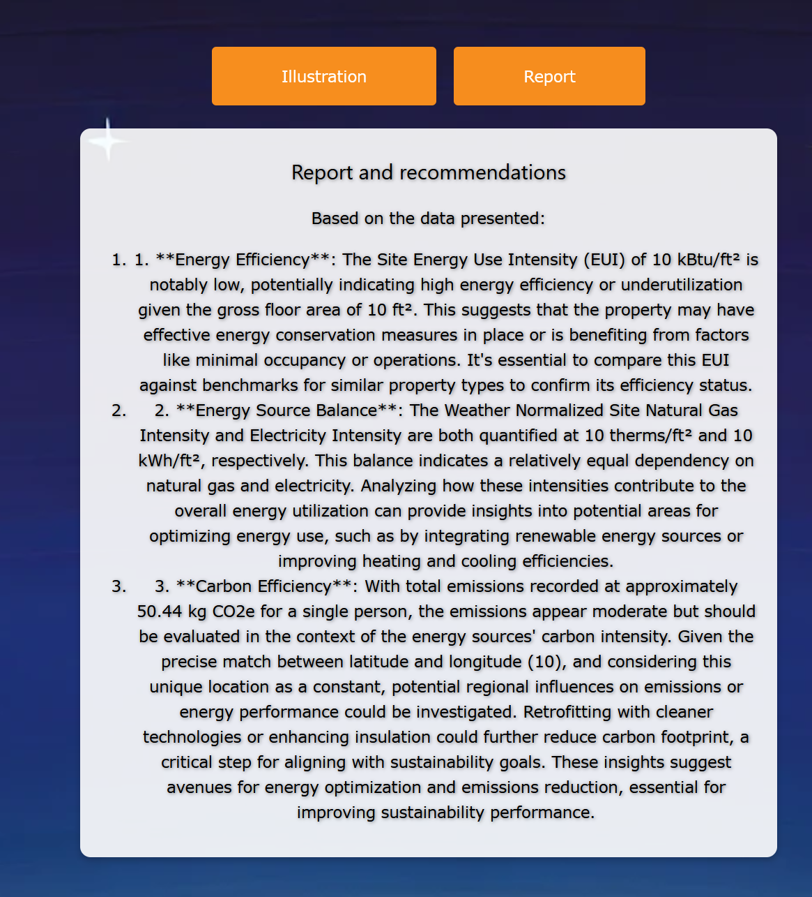
Result Illustrations and Report
Per Capita and Per Square Meter Comparison With Benchmark
AI-Generated Report and Recommendations

Slide 14
Demo

Slide 15
Thank you!

Slide 16
Team Contacts
HONG WEICHENG
LIANG YUANYUAN
NG QIWEN ALVIN
YOU ZUODONG
e1352864@u.nus.edu
e1351854@u.nus.edu
e1353302@u.nus.edu
e1353102@u.nus.edu
LI ZHUOYANG
LIU JINYANG
WANG YUANJIA
ZOU CHENYANG
e1351476@u.nus.edu
e1352338@u.nus.edu
e1351192@u.nus.edu
e1352823@u.nus.edu

